Slide 1
ROCO218: Control Engineering Dr Ian Howard Tutorial 2 ROCO218 2016R Exam examples Derive transfer function for electrical system

Slide 2
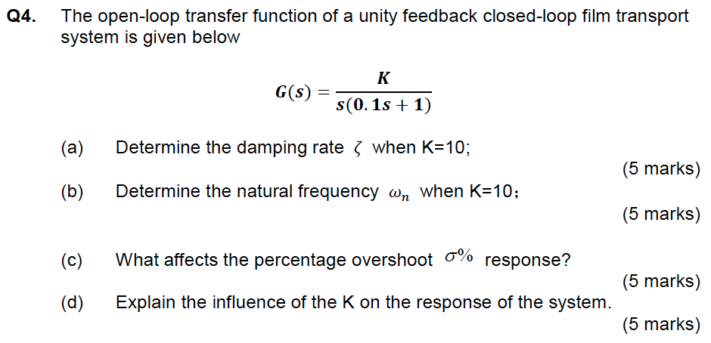
Q3: Canonical 2nd order form

Slide 3
Q3: Canonical 2nd order form
The open loop function is
Therefore the unity feedback closed loop transfer function is
Substituting in K=10

Slide 4
Q3: Canonical 2nd order form
Comparing with canonical form
The percentage overshoot is given by
Matlab
100*exp(-0.5*pi/(sqrt(1-0.5^2)))
Peak time T_{p} of the step response
Matlab
pi/(10 * sqrt(1-0.5^2))
As K increases overshoot increases but peak time is not affected

Slide 5
ROCO218: Control Engineering Dr Ian Howard Tutorial 2 2015 exam for ROCO316 Modern Control Solutions to relevant questions

Slide 6
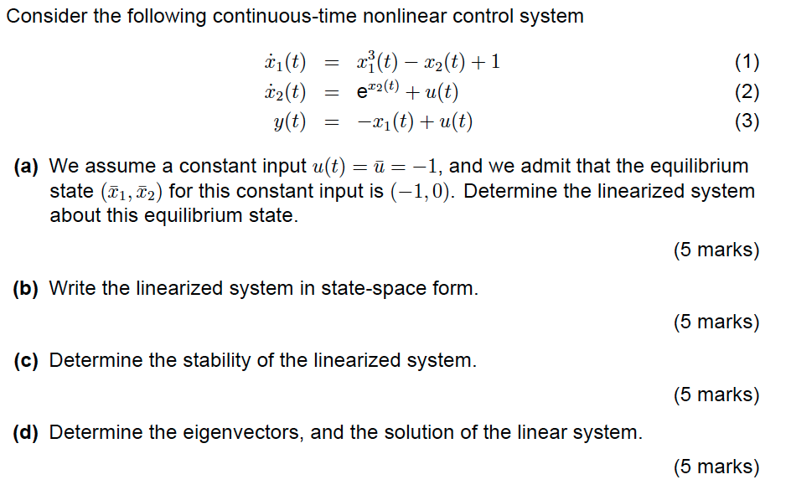
Q1: Continuous-time nonlinear control system

Slide 7
Q1: Continuous-time nonlinear control system
Solution: Substituting in value of u(t) = -1 gives the equations
To linearize we need to calculate the Jacobian matrix and evaluate it at the given equilibrium position (-1,0).
In general the Jacobian is given by

Slide 8
Q1: Continuous-time nonlinear control system
Here we only have a 2x2 matrix
The corresponding functions we need f₁ and f₂ are given by the two state expressions
Taking partial derivatives w.r.t. to the state variables
The equilibrium point is given as (-1,0) so we evaluate the Jacobian matrix at this point

Slide 9

Q1: Continuous-time nonlinear control system
From the Jacobian
we can directly write

Slide 10

Q1: Continuous-time nonlinear control system
To determine the stability of the system we need to calculate the eigenvalues of Jacobian matrix J which is now our system matrix A
The eigenvalues of matrix A must satisfy the equation
Where X is the state vector
Where I is the identity matrix
This equation has a non-zero solution X if and only if the determinant of the matrix (A-I)=0
Where straight bracket signifies the determinant

Slide 11
Q1: Continuous-time nonlinear control system
Substituting A and I into the expression
For a 2x2 matrix the determinant is given by
Note also that since the A matrix is of triangular form, its leading diagonal values indicate the eigenvalues of 3 and 1 directly. However we calculated the values for thoroughness of methodology since this will not always be the case
Both eigenvalues are strictly positive and therefore the linearized system is unstable

Slide 12

Q1: Continuous-time non-linear control system
The eigenvalues of a matrix A satisfy the equation
The values of X gives the eigenvector
When λ=1
When λ=3

Slide 13
ROCO218: Control Engineering Dr Ian Howard Tutorial 2 2016R exam for ROCO319 Modern Control Solutions to relevant questions

Slide 14
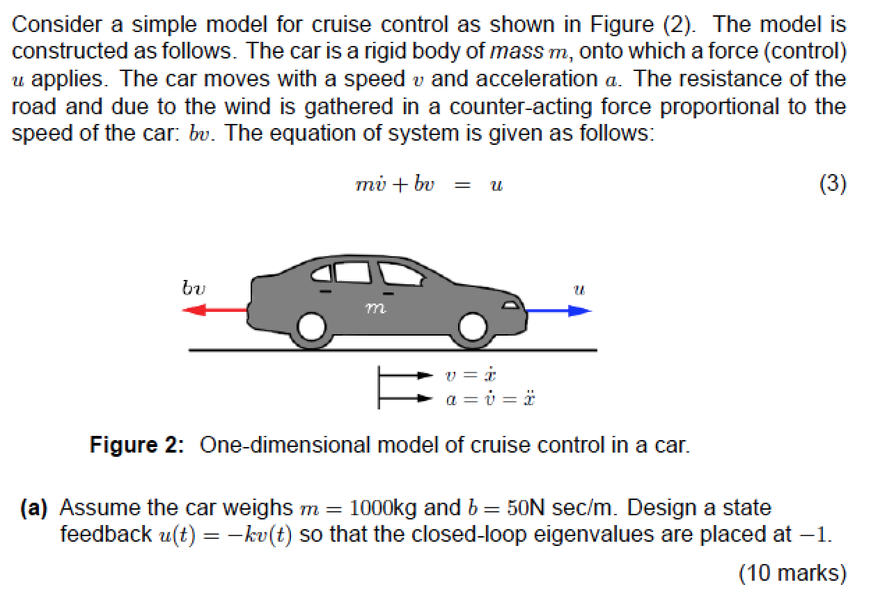
Q3: State space analysis

Slide 15
Q3: State space analysis
Dynamic equation is
Which can be rewritten as
State space equations take the form
Representing the single state by x, the system state space equation is
Substituting in values
Therefore the system matrices are

Slide 16
Q2: State space analysis
Given system matrix A
We went asked to, but lets calculate the open loop stability first for practice
The eigenvalues of matrix A must satisfy the equation
Where X is the state vector
Where I is the identity matrix
This equation has a non-zero solution X if and only if the determinant of the matrix (A-I)=0
For a 1x1 matrix the determinant is given by
The eigenvalue has a negative real value
Therefore the open loop system is stable

Slide 17
Q3: State space analysis
State space equations take the form
Therefore when we apply state feedback
Where
The stability is now determined by location of poles which are the eigenvalue of matrix (A-BK)
The eigenvalue λ of the closed loop system are thus given by
To set the eigenvalue λ of the closed loop system to -1

Slide 18
ROCO218: Control Engineering Dr Ian Howard Tutorial 2 2016 exam for ROCO319 Modern Control Solutions to relevant questions

Slide 19
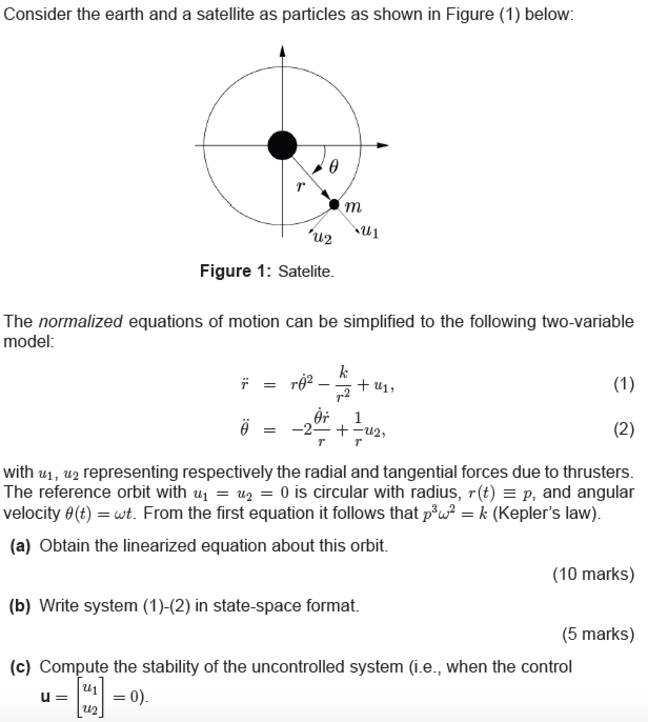
Q1: Linearizing a non-linear system

Slide 20
Q1: Linearizing a non-linear system
The differential equations that describe the system are
Choosing state variables, which will be lower order than highest order terms in the equations we have

Slide 21
Q1: Linearizing a non-linear system
So we now have 3 single order equations
So we can write the functions
To linearize the system we need to calculate the system Jacobian
Evaluating the partial derivates w.r.t. the state variables

Slide 22
Q1: Linearizing a non-linear system
So we now have 3 single order equations
So we can write the functions
Evaluating the partial derivates w.r.t. the state variables

Slide 23
Q1: Linearizing a non-linear system
Again using the function definitions
To linearize the control input we need to calculate the control Jacobian
Evaluating the partial derivates w.r.t. the control variables

Slide 24
Q1: Linearizing a non-linear system
We need to evaluate the Jacobians at the equilibrium corresponding to the reference orbit using the values
u₁=0, u₂= 0
x₁=0, x₂=p, x₃=ω
k=p³ω²

Slide 25
Q1: Linearizing a non-linear system
The state space equations are therefore
To determine stability of the uncontrolled system we need to examine the eigenvalues of the system matrix A
The eigenvalues of matrix A must satisfy the equation

Slide 26
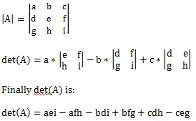
Q1: Linearizing a non-linear system
The determinant of
3x3 matrix determinant
Has the characteristic equation
So solutions are
Eigenvalues λ=0, ±jω

Slide 27
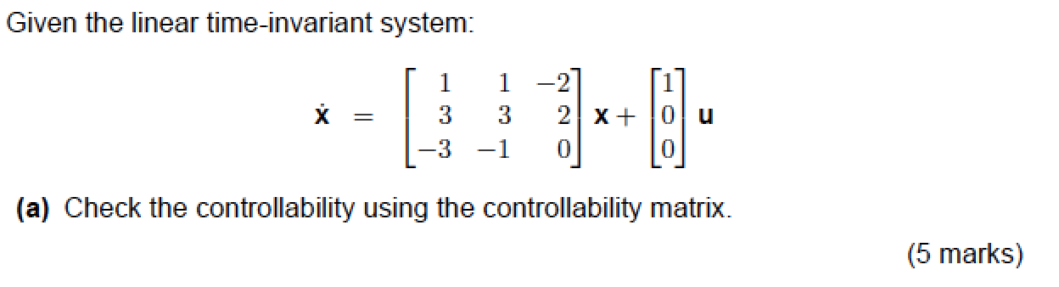
Q2: Controllability

Slide 28
Q2: Controllability
State space equations take the form
The given system state space equations is
Therefore the system matrices are
The system matrix is 3x3
Therefore the system will have a 3x3 system matrix

Slide 29
Q2: Controllability
Our system will have a 3x3 system matrix
Calculating the AB term gives
Calculating the A²B term gives

Slide 30
Q2: Controllability
We now reduce the controllability matrix to echelon form
The controllability matrix thus has rank = 2, which is not full rank
Therefore the system is not controllable

